Slide 1
The Program Dependence Graph

Slide 2
Program Dependence Graph
The Program Dependence Graph (PDG) is the intermediate (abstract) representation of a program designed for use in optimizations
It consists of two important graphs:
Control Dependence Graph captures control flow and control dependence
Data Dependence Graph captures data dependences

Slide 3
Control Flow Graphs

Slide 4
Control Flow Graphs
Motivation: language-independent and machine-independent representation of control flow in programs used in high-level and low-level code optimizers.

Slide 5
The Basic Block
The maximal sequence of code where executing the first instruction will be followed by the second, etc. till the end of the sequence without any intervening branch instructions
Single entry, single exit
Procedure calls are considered “normal” instructions

Slide 6
Control Flow Graph: Definition
A control flow graph CFG = ( N_{c} ; E_{c} ; T_{c} ) consists of
N_{c}, a set of nodes. A node represents a basic block.
E_{c} ⊆ N_{c} x N_{c} x Labels, a set of labeled edges.

Slide 7
Definition (cont’d)
T_{c} , a node type mapping. T_{c}(n) identies the type of node n as one of: START, STOP, OTHER.
We assume that CFG contains a unique START node and a unique STOP node, and that for any node N in CFG, there exist directed paths from START to N and from N to STOP.

Slide 8
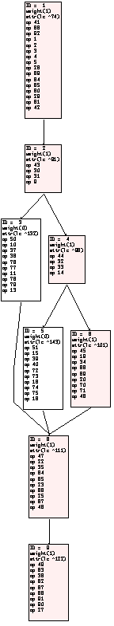
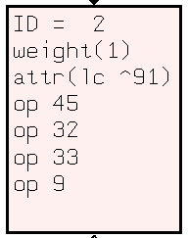
A typical CFG
main(int argc, char *argv[ ])
{
if (argc == 1) {
printf("1");
} else {
if (argc == 2) {
printf("2");
} else {
printf("others");
}
}
printf("done");
}
BB1
BB2
BB3
BB4
BB5
BB6
BB8
BB9

Slide 9
Dominators: Definition
Node V dominates another node W ≠ V if and only if every directed path from START to W in CFG contains V.
Define dom ( W ) = { V | V dominates W } , the set of dominators of node W.

Slide 10
Dominators (cont’d)
Consider any simple path from START to W containing W 's dominators in the order V₁,…,V_{k}. Then all simple paths from START to W must contain W 's dominators in the same order. The element closest to W, V_{k} = idom (W), is called the immediate dominator of W.
- A path is simple if none of the nodes on the path is repeated.

Slide 11
Dominator Tree
The idom relation can be represented as a directed tree with root = START, and parent(W) = idom (W ).

Slide 12
Postdominators: Definition
Node W postdominates another node V ≠ W if and only if every directed path from V to STOP in CFG contains W
Define pdom (V) = { W | W postdominates V}, the set of postdominators of node V

Slide 13
Definition (Contd)
Consider any simple path from V to STOP containing V’s postdominators in the order W₁,…,W_{k}. Then all simple paths from V to STOP must contain V’s postdominators in the same order. The element closest to V, W₁ = ipdom(V), is called the immediate postdominator of V.
The ipdom relation can be represented as a directed tree with root = STOP and parent(V) = ipdom(V)

Slide 14
Example: Dominator and Postdominator Trees
STOP
START
3
START
T
T
1
2
T
F
POST-DOMINATOR TREE
F
1
T
2
F
START
3
F
1
STOP
STOP
2
DOMINATOR TREE
CONTROL FLOW GRAPH
3

Slide 15
A Simple Algo to compute Dominators
Node a dominates node b if and only if any of the following condition holds (“or”):
a = b
a is the unique immediate predecessor of b
b has more than one predecessor and for all immediate predecessors c of b, c ≠ a and a dominates c
In other words: the dominators of a node is the intersection of the dominators of all its immediate predecessors

Slide 16
Dominates(n)
Dominates(ENTRY) = {ENTRY}
For all other nodes n,
Dominates(n) = Dominates(p) ∪ {n}
∩
p ∈ pred(n)

Slide 17
Computing Dominators - 1
Input: G = ⟨N, E⟩ a flow graph Locals: change_flag - a boolean flag D, T - sets of nodes n, p - nodes Output: Dominates – the set of dominators of a particular node
change_flag ← true Dominates(ENTRY) ← ENTRY
for every n ∈ N, Dominates(n) ← N

Slide 18
Computing Dominators - 2
repeat until change_flag = false
change_flag ← false
for each n ∈ N − { ENTRY } do
T ← N
for each p such that p → n ∈ E T ← T ∩ Dominates(p)
D ← T ∪ { n }
if D ≠ Dominates(n) then change_flag ← true Dominates(n) ← D

Slide 19
Iterative Refinement
The initialization of Dominates(n) to N is important
The “intersect” operator will “refine” the set, reducing its size by “increasing” its correctness
More on this when we do Dataflow Analysis

Slide 20
A Faster Approach – Lengauer and Tarjan’s Algo
Simple version: O( E x logN )
Sophisticated version: O( E x α(E,N))
α is the inverse Ackermann’s function

Slide 21
Depth First Search
dfs(v)
{
visit(v);
for each child w of v
if w is unvisited
{ dfs(w);
// Build depth first spanning tree T
add edge v→w to tree T
}
}

Slide 22
Depth-First Search
A
B
C
D
E
F
G

Slide 23
Depth-First Search
1
A
B
C
D
E
F
G

Slide 24
Depth-First Search
1
A
2
B
C
D
E
F
G

Slide 25
Depth-First Search
1
A
2
B
C
D
3
E
F
G

Slide 26
Depth-First Search
1
A
2
B
C
D
3
E
F
G
4

Slide 27
Depth-First Search
1
A
2
B
C
D
5
3
E
F
G
4

Slide 28
Depth-First Search
1
A
2
B
C
D
5
3
E
F
6
G
4

Slide 29
Depth-First Search
1
A
2
B
7
C
D
5
3
E
F
6
G
4

Slide 30
Depth-First Spanning Tree
1
A
2
B
7
C
D
5
3
E
F
6
G
4

Slide 31
Some definitions
A node v is an ancestor of node w if
v = w or
there is a path in the depth first spanning tree from v to w
Node v is a proper ancestor of node w if v is an ancestor of w and v ≠ w
Let dfn(v) be the depth first numbering of node v. Let T be the depth first spanning tree

Slide 32
Semidominators
The semidominator of a node w (w ≠ START) is the node v with the smallest depth first number such that there is a path v₀→ v₁ → … → v_{k-1} → w, such that v = v₀ and dfn(v_{i}) > dfn(w) for 1 ≤ i ≤ k-1
Let sdno(w) be the depth first number of the semidominator of w

Slide 33
Semidominators
1
A
2
B
7
C
D
5
3
E
F
6
G
4

Slide 34
Semidominators
1
A
2
B
7
C
D
5
3
E
F
A
6
G
4

Slide 35
Semidominators
1
A
2
B
7
C
A
D
A
A
5
3
E
B
F
A
6
G
D
4

Slide 36
Key Insight
For all w ≠ START, the semidominator is a proper ancestor of w in the depth-first spanning tree, and the immediate dominator of w is a (not necessary proper) ancestor of the semidominator of w in the same tree

Slide 37
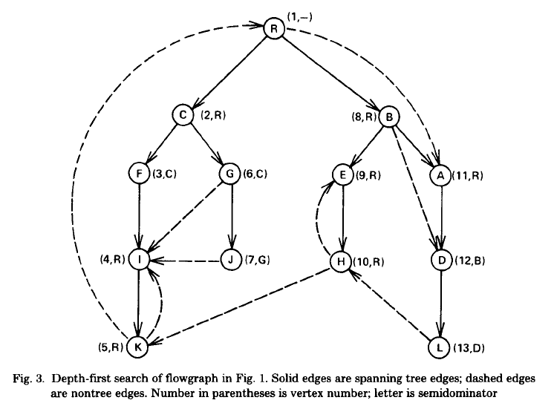
An Example

Slide 38

Semidominators as approximations to dominators
For most nodes, the semidominator is the immediate dominator
This edge is the “culprit”
Dominator = R
Semidominator = B

Slide 39
Property 1
For any two nodes v and w with dfn(v) ≤ dfn(w), any path from v to w must include a common ancestor of v and w in the depth-first spanning tree, T

Slide 40
An Example
dfn(v) ≤ dfn(w)
v
w

Slide 41
An Example
dfn(v) ≤ dfn(w)
v
w

Slide 42
Property 2
Let G = ⟨N, E⟩ be a flowgraph.
Let E_{n} be the edges of G not found in the depth-first spanning tree
Let E_{s} = { w → v | v ∈ N and w is the semidominator of v}
Let E’ = E – E_{n} + E_{s}
then G’ = ⟨N, E’ ⟩ has exactly the same set of dominators as G.

Slide 43
Property 3 – to compute semidominators
Let
V(w) = { dfn(v) | v → w ∈ E and dfn(v) < dfn(w) }
S(w) = { sdno(u) | dfn(u) > dfn(w) and for some v’ ∈ N, v’ → w ∈ E and there is a path from u to v’ in T }
then the semidominator of w is the node with the depth-first number of min(V(w) ∪ S(w))

Slide 44
An Example
V(w) = {4}
S(w) = {sdno(E), sdno(B)}
= {1}
sdno(w) = 1
sdno(u)
u
u
v
v’
w

Slide 45
Property 4
Given a non-root node v and v_{s} its semidominator. Let u be a node whose semidominator u_{s} has the minimal dfn() such that in the depth-first spanning tree:
There is a non-empty path from v_{s} to u, and
There is a path from u to v
then
idom(v) = v_{s} if dfn(v_{s}) = dfn(u_{s})
idom(v) = idom(u) otherwise

Slide 46
An Example
u_{s}
dfn(v_{s}) ≠ dfn(u_{s})
v_{s}
u
v

Slide 47
The Algorithm – some preliminaries
Let B(w) be the set of nodes which has w as its semidominators
Let vertex(i) be the vertex v such that dfn(v) = i
idom(w):
After Step 2, idom(w) is either
The immediate dominator of w, OR
A node v such that dfn(v) < dfn(w) and whose immediate dominator is also w’s immediate dominator
After Step 3, idom(w) is the immediate dominator of w

Slide 48
The Algorithm – some preliminaries
semi(w):
Before dfn(w) is computed, semi(w) = 0
Before semidominator is computed, semi(w) = dfn(w)
After semidominator is computed, semi(w) = sdno(w)

Slide 49
The Algorithm – some preliminaries
We track progress by means of a forest of sub-trees of the depth-first spanning tree, T = ⟨N, E_{T}⟩. More precisely, this is the graph F = ⟨N, E_{F}⟩ where
E_{F} = { v → w | v → w ∈ E_{T}
and w has been processed }

Slide 50
The Algorithm – some preliminaries
Two auxiliary functions:
LINK(v, w): Add an edge v → w into a forest of sub-trees within the depth-first spanning tree of the CFG
EVAL(v): If v is the root of a tree in the forest, return v. Otherwise, let r be the root of the tree containing v. Return any vertex u ≠ r with the min(semi(u)) on the path from r to v.

Slide 51
The Lengauer-Tarjan Algorithm
Step 1: Compute the dfn() of all nodes in a CFG G = ⟨N, E⟩ as well as the depth-first spanning tree, T = ⟨N, E_{T}⟩, by means of a depth-first traversal

Slide 52
The Lengauer-Tarjan Algorithm
Step 2: Traverse the CFG in reversal depth-first order from the largest dfn() backwards. Let w be the current vertex.
Step 2.1: For all v→ w ∈ E,
let u = EVAL(v)
If semi(u) < semi(w), then set semi(w) = semi(u) (Property 3)
Add w to B(vertex(semi(w)))
LINK(z, w) where z → w ∈ E_{T}

Slide 53
The Lengauer-Tarjan Algorithm
Step 2.2: For all v ∈ B(z) where z → w ∈ E_{T},
Delete v from B(z)
let u = EVAL(v)
If semi(u) < semi(w), then set idom(v) = u; else idom(v) = z (Property 4)

Slide 54
The Lengauer-Tarjan Algorithm
Step 3: Traverse the CFG in forward depth-first order. Let w be the current node.
If idom(w) ≠ vertex(semi(w)), then set idom(w) = idom(idom(w)) (Second part of Property 4)

Slide 55
Algorithms for computing Dominator/Postdominator
[Purdom and Moore, 1972] O( N x E ) execution time
[Lengauer and Tarjan, 1979]
Simple version: O( E x logN ) execution time. Sophisticated version: O( E x α(E,N )) execution time
[Harel, 1985] O( N + E ) execution time

Slide 56
Loop Nesting Structure of a Control Flow Graph
The loop nesting structure of a CFG is revealed by its interval structure:
Edge e = ( x, h, l ) in CFG is called a back edge if h ∈ dom (x); h is called a header node, and x is called a latch node.

Slide 57
A little digression
Given a directed graph G = ⟨N, E⟩
A Strongly Connected Component (SCC) of G is a subgraph of G, G_{S} = ⟨N_{S}, E_{S}⟩, such that
N_{S} ⊆ N, E_{S} ⊆ E
for every node, u ∈ N_{S} there is a path to every node v ∈ N_{S} − {u}, u → v₁ → v₂ → ... → v_{i} → v_{i+1} → ... → v such that v_{i} → v_{i+1} ∈ E_{S}

Slide 58
An DFS Algorithm for Computing SCCs
Given a graph G=(V, E)
Perform a DFS of G, numbering the vertices in order of completion of the recursive calls to DFS.
Construct G_{T} =(V, E’), the transpose graph of G where
E’ = {(v, u) : (u, v) ∈ E}

Slide 59
An DFS Algorithm for Computing SCCs – cont’d
Perform a DFS on G_{T} starting the search from the highest numbered vertex according to the numbering assigned at step 1. If the DFS does not reach all vertices, start the next DFS from the highest numbered remaining vertex.
Each tree in the resulting spanning forest of the second DFS is a SCC of G.

Slide 60
An Example

Slide 61
An Example

Slide 62
An Example

Slide 63
An Example
1

Slide 64
An Example
1
2

Slide 65
An Example
1
2

Slide 66
An Example
1
2

Slide 67
An Example
1
2
3

Slide 68
An Example
4
1
2
3

Slide 69
An Example
5
4
1
2
3

Slide 70
An Example
Transpose Graph
5
4
1
2
3

Slide 71
An Example
Transpose Graph
5
4
1
2
3

Slide 72
An Example
Transpose Graph
5
4
1
2
3

Slide 73
An Example
Transpose Graph
5
4
1
2
3

Slide 74
An Example
Transpose Graph
5
4
1
2
3

Slide 75
An Example
Transpose Graph
5
4
1
2
3

Slide 76
An Example
Transpose Graph
5
4
1
2
3

Slide 77
An Example
Transpose Graph
SCC1
5
4
SCC3
SCC2
1
2
3

Slide 78
Back edge → Loop
The strongly connected component defined by back edge e = ( x, h, l ) is STR(e), which consists of the nodes and edges belonging to all paths from node h to node x, along with the back edge (x,h, l).
The interval with header h, I(h), is defined as the union of STR(e) over all back edges e targeted to header node h.

Slide 79
Loop Nesting Structure of a Control Flow Graph (Contd.)
Interval nesting is defined by the subgraph relationship. I(h₁) is a subinterval of I(h₂) if I(h₁) is a subgraph of I(h₂)
The interval nesting relation can then be represented by a unique interval nesting tree (or forest of trees)

Slide 80
Loop Nesting Structure of a Control Flow Graph (Contd.)
It is convenient to add a pseudo-edge from STOP to START to make START a header node with I(START) = entire CFG, and thus force the interval relation to be a single tree

Slide 81
Reducible Control Flow Graphs
A CFG is reducible if and only if the directed graph obtained by removing all back-edges is acyclic. This graph is referred to as the forward control flow graph.

Slide 82
Example: Interval Structure for a Reducible CFG
START
I(START)
T
I(START)
T
*
1
I(1)
*
*
F
I(1)
T
*
F
T
2
I(2)
F
I(2)
3
F
INTERVAL NESTING TREE
STOP
* Back edge
INTERVALS IN A CONTROL FLOW GRAPH

Slide 83
Example: Interval Structure for an Irreducible CFG
I START
START
T
F
I(START)
T
1
2
*
*
I(1)
F
I(1)
T
T
3
F
F
INTERVAL NESTING TREE
STOP
* Back edge
INTERVALS IN A CONTROL FLOW GRAPH

Slide 84
Data and Control Dependences
Motivation: identify only the essential control and data
dependences which need to be obeyed by
transformations for code optimization.
Program Dependence Graph (PDG) consists of
1. Set of nodes, as in the CFG
2. Control dependence edges
3. Data dependence edges
Together, the control and data dependence edges
dictate whether or not a proposed code transformation
is legal.

Slide 85
Control Dependence Analysis
Two related ideas:
Node Y should be control dependent on node X if node X evaluates a predicate (conditional branch) which can control whether node Y will subsequently be executed or not. This idea is useful for determining whether node Y needs to wait for node X to complete, even though they have no data dependences.

Slide 86
Control Dependence Analysis (contd.)
2. Two nodes, Y and Z, should be identified as having identical control conditions if in every run of the program, node Y is executed if and only if node Z is executed. This idea is useful for determining whether nodes Y and Z can be made adjacent and executed concurrently, even though they may be far apart in the CFG.

Slide 87
Control Dependence: Definition
[Ferrante et al, 1987]
Node Y is control dependent on node X with label L in CFG if and only if
there exists a nonnull path X → Y, starting with the edge labeled L, such that Y post-dominates every node, W, strictly between X and Y in the path, and
Y does not post-dominate X

Slide 88
Direct and Indirect CD
Y is control dependent on X only if X can directly affect whether Y is executed or not
Indirect control dependence can be defined as the transitive closure of control dependence

Slide 89
Example: acyclic CFG and its Control Dependence Graph
START
STOP
F
T
1
START
3
1
4
T
T
F
2
2
3
POSTDOMINATOR TREE
u
4
u
START
u
T
STOP
1
T
T
F
2
4
3
CONTROL FLOW GRAPH
CONTROL DEPENDENCE GRAPH

Slide 90
Example: CFG with multi-way branch and its CDG
START
STOP
F
T
START
3
1
2
1
<0
F
2
3
POSTDOMINATOR TREE
=0
START
u
u
T
1
STOP
<0
>0
2
=0
3
CONTROL FLOW GRAPH
CONTROL DEPENDENCE GRAPH

Slide 91
Algorithm for Computing Control Dependence
Given node X and branch label L, all control
dependence successors can be enumerated as
follows:
1. Z ← CFG successor of node X with label L
2. while Z ≠ ipdom(X) do
(a) /* Z is control dependent on X with label
L — process Z as desired */
(b) Z ← ipdom(Z)
end while

Slide 92
Example: cyclic CFG and its Control Dependence Graph
START
STOP
F
T
START
3
1
4
1
T
T
F
POSTDOMINATOR TREE
2
2
3
T
u
START
4
u
T
F
1
STOP
T
T
F
2
4
3
CONTROL FLOW GRAPH
CONTROL DEPENDENCE GRAPH

Slide 93
Example: another cyclic CFG and its CDG
START
STOP
T
3
ENTRY
T
1
F
2
F
POST-DOMINATOR TREE
T
2
1
F
ENTRY
3
T
T
T
F
STOP
T
3
T
2
T
1
CONTROL FLOW GRAPH
CONTROL DEPENDENCE GRAPH

Slide 94
Properties of Control Dependence
CDG is a tree → CFG is structured
CDG is acyclic → CFG is acyclic
CDG is cyclic → CFG is cyclic

Slide 95
Properties of CD
The control conditions of node Y is the set,
CC(Y) = {(X,L)|Y is control dependent on X with label L}
Two nodes, A and B, are said to be identically control dependent if and only if they have the same set of control conditions i.e. CC(A) = CC(B)

Slide 96
Data Dependence Analysis
If two operations have potentially interfering data accesses, data dependence analysis is necessary for
determining whether or not an interference actually exists. If there is no interference, it may be possible to reorder the operations or execute them concurrently.

Slide 97
Data Dependence Analysis
The data accesses examined for data dependence analysis may arise from array variables, scalar variables, procedure parameters, pointer dereferences, etc. in the original source program.

Slide 98
Data Dependence Analysis
Data dependence analysis is conservative, in that it may state that a data dependence exists between two statements, when actually none exists.

Slide 99
Data Dependence: Definition
A data dependence, S₁ → S₂, exists between CFG
nodes S₁ and S₂ with respect to variable X if and only if
1. there exists a path P such that S₁ → S₂ in CFG, with no intervening write to X, and
2. at least one of the following is true:
(a) (flow) X is written by S₁ and later read by S₂, or
(b) (anti) X is read by S₁ and later is written by S₂ or
(c) (output) X is written by S₁ and later written by S₂

Slide 100
Def and Use
A variable is defined if it is on the left hand side of an assignment
Its previous value is said to be killed
A variable that is defined but not killed is said to be live
A variable is used if there is a read access to it in the current instruction

Slide 101
Def/Use chaining for Data Dependence Analysis
A def-use chain links a definition D (i.e. a write access of variable X to each use U (i.e. a read access), such that there is a path from D to U in CFG that does not redefine X

Slide 102
Use-def, Def-def
Similarly, a use-def chain links a use U to a definition D, and a def-def chain links a definition D to a definition D’ (with no intervening write to X in all cases)
Def-use, use-def, and def-def chains can be computed by data flow analysis, and provide a simple but conservative way of enumerating flow, anti, and output data dependences

Slide 103
Static Single Assignment
An special representation of the def-use chain to capture data flow
Useful for optimizations

Slide 104
Properties of SSA
Each use of a variable is reached by exactly one assignment to that variable
φ -functions are inserted to distinguish values of variables transmitted on different incoming control flow edges

Slide 105
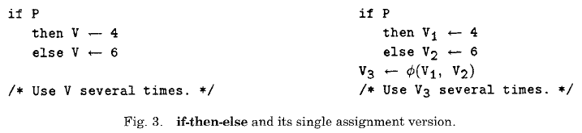
An Example

Slide 106
φ -functions
A φ -function has the form
U ← φ (V₀, V₁, …, V_{n-1})
where U, V₀, V₁, …, V_{n-1} are variables and the number of operands to the φ -function is the number of control flow predecessors

Slide 107
φ -functions
If control reaches the φ -function from its j-th predecessor, then U is assigned the value of V_{j}

Slide 108
Constructing the SSA form
Two major phases:
Inserting of φ -function
Renaming of variables to create a unique name for each definition
Second problem is easy

Slide 109
Minimal SSA Form
The main difficult: finding the SSA with the minimal number of φ -functions
Can use the computation of dominators

Slide 110
Strict Dominance
If X dominates Y and X ≠ Y, then we say that X strictly dominates Y
Notations: we will write “X dom Y” for “X dominates Y”
we will write “X sdom Y” for “X strictly dominates Y”
we will write “X idom Y” for “X is the immediate dominator of Y”

Slide 111
Dominance Frontier
The dominance frontier DF(X) of a node X in a CFG is the set of all CFG nodes, Y, such that X dominates a predecessor of Y but does not strictly dominates Y
DF(X) = {Y | ∃Z ∈ Pred(Y) such that
X dom Z and X !sdom Y}

Slide 112
Computing DF
Computing DF directly is O(V²) – quadratic in the number of nodes of the CFG
A more efficient algorithm breaks the computation into three parts

Slide 113
Computing DF efficiently
DF_{local}(X) = {Y ∈ Succ(X) | X !idom Y}
DF_{up}(X, Z) = {Y ∈ DF(Z) | X !idom Y}

Slide 114
Iterated DF
For a set of nodes S of a CFG, we define
Let
DF¹(S) = DF(S)
DF^{i+1}(S) = DF(S ∪ DF^{i}(S))

Slide 115
Iterated DF – cont’d
Iterated Dominance Frontier
In practice, iterate till there is no change in the solution

Slide 116
DF⁺ → φ -functions
If S is the set of CFG nodes that contains assignment to variable X, plus the ENTRY node, then DF⁺(S) is exactly the nodes in which φ -functions needs to be inserted for X
O(E + T + DF)
E = # of CFG edges, T = # of assignments, DF = total size of DFs

Slide 117
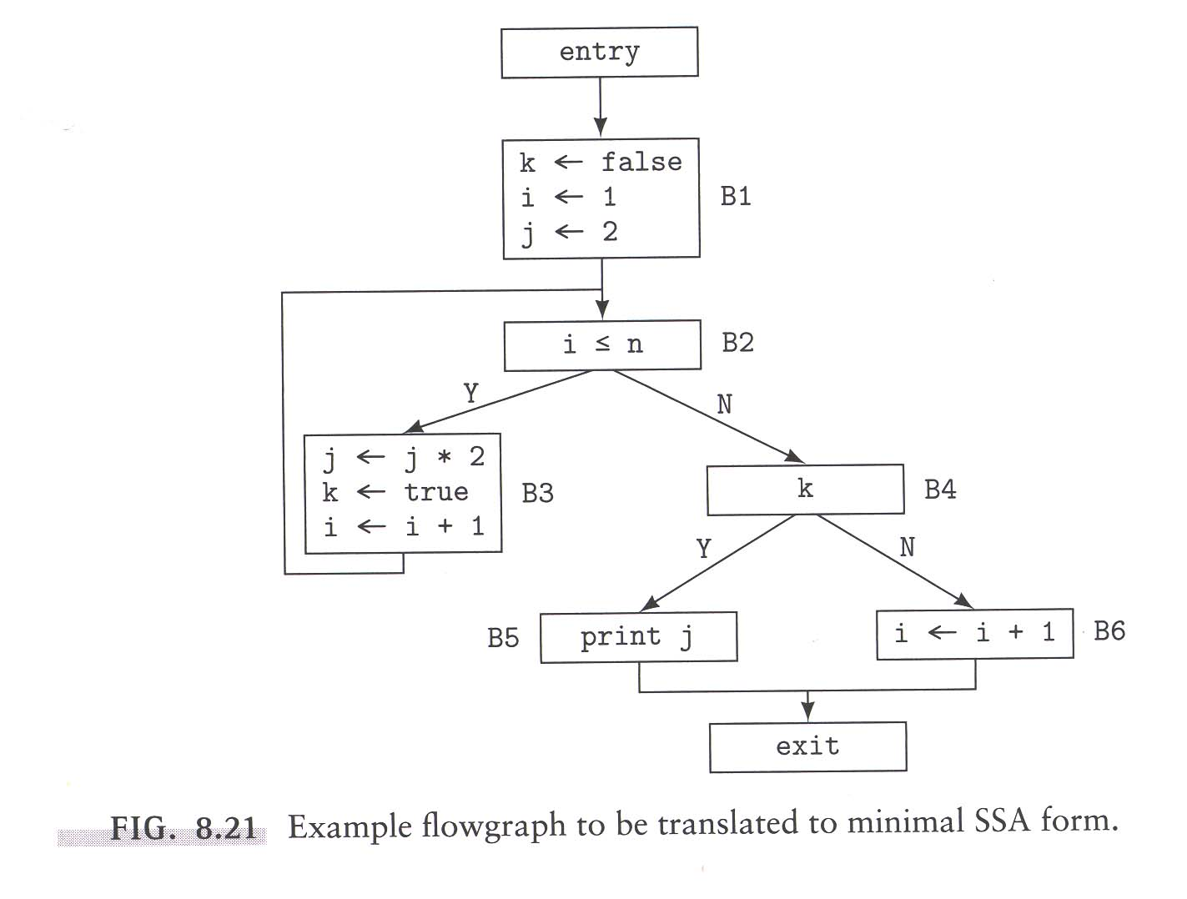
An Example

Slide 118
Example – cont’d
ENTRY
B1
B2
B3
B4
B5
B6
EXIT
Dominator Tree

Slide 119
Example – cont’d
For variable k,
DF1({ENTRY, B1, B3} = {B2}
DF2({ENTRY, B1, B3} = DF({ENTRY, B1, B2, B3}) = {B2}
For variable i,
DF1({ENTRY, B1, B3, B6} = {B2, EXIT}
DF2({ENTRY, B1, B3, B6} = DF({ENTRY, B1, B2, B3, B6, EXIT}) = {B2, EXIT}
For variable j,
DF1({ENTRY, B1, B3} = {B2}
DF2({ENTRY, B1, B3} = DF({ENTRY, B1, B2, B3}) = {B2}

Slide 120
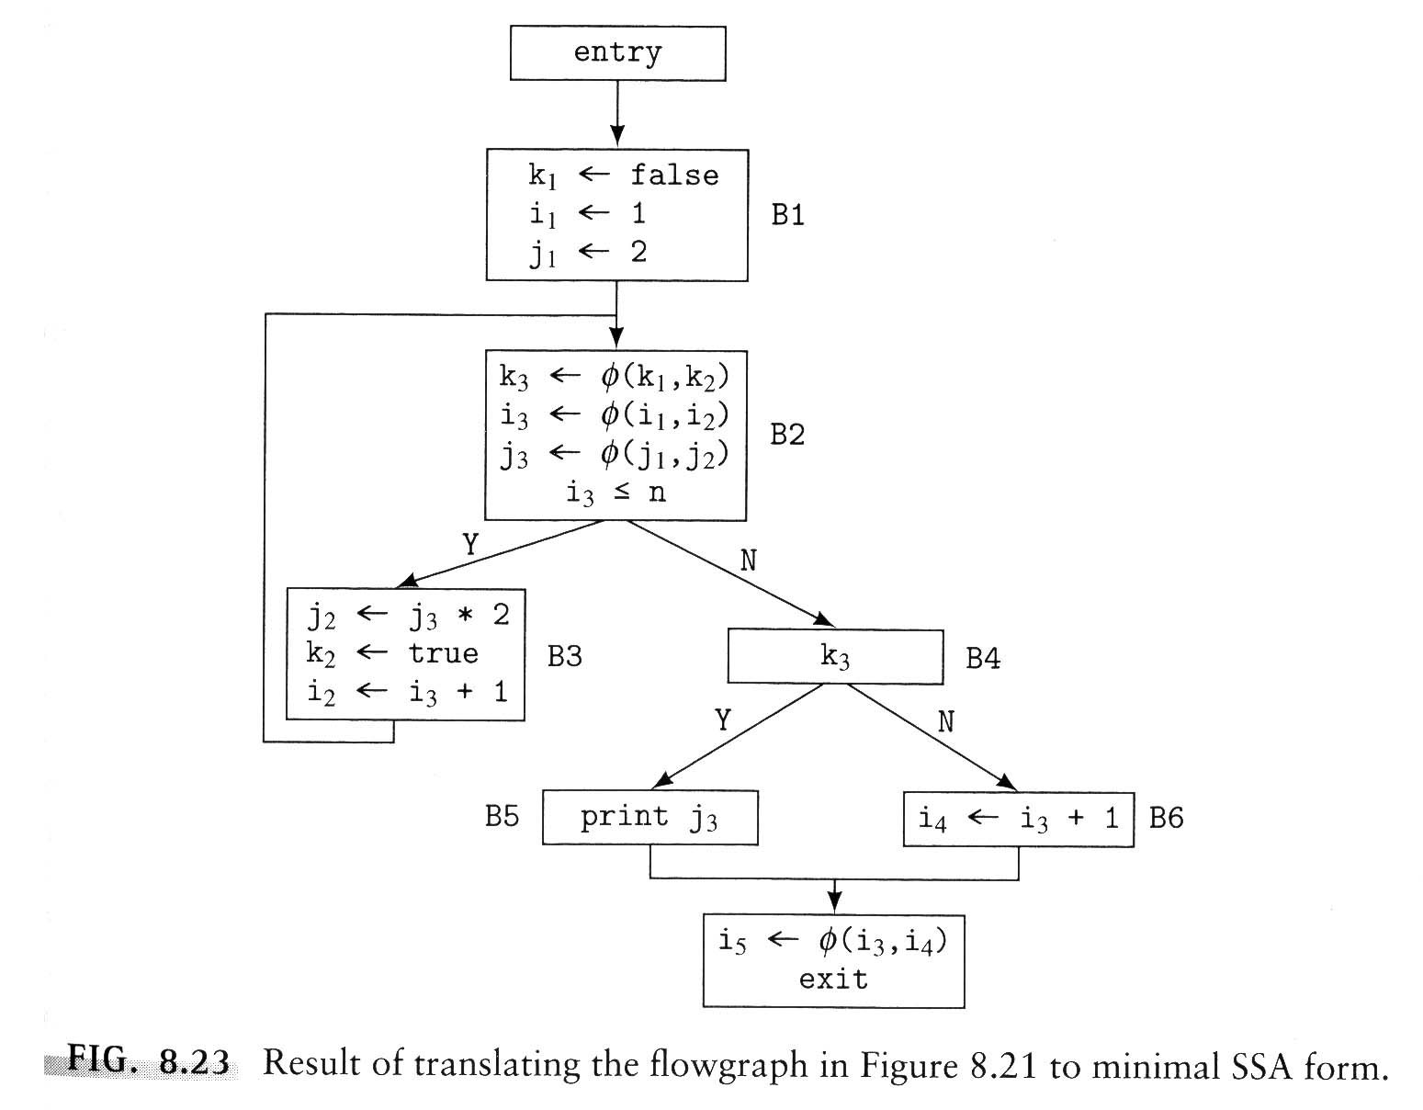
Final SSA Form

Slide 121
Conversion back to code
SSA is a conceptual tool
Need to eliminate φ -functions

Slide 122
Conversion back to code
SSA is a conceptual tool
Need to eliminate φ -functions
Simple: rename all variables back to their original names

Slide 123
The Reverse Control Flow Graph
Let CFG = {V, E}. Then we can define the reverse CFG (RCFG) = {V’, E’} where
V = V’
If X → Y ∈ E, then Y → X ∈ E’

Slide 124
Computing Control Dependence
Theorem: Let X and Y be nodes in a CFG. Then Y is control dependent on X in the CFG if and only if X ∈ DF(Y) in the RCFG

Slide 125
Example of Using SSA
Induction variable in a loop:
k = 0; /* Induction variable */
while (…) {
… = A(k) + …;
k = k + 4;
…
}

Slide 126
Basic Induction Variable
In a loop of the form:
for (i=C₁; i<C₂; i+=C₃) {…}
the variable i is the basic induction variable

Slide 127
Auxiliary Induction Variables
An auxiliary (or dependent) induction variable is any variable that is computed by the formula
E₁ * i + E₂
where i is a basic induction variable, and E₁ and E₂ are arithmetic expressions that do not vary in the loop, although at different locations, they may be different

Slide 128
Induction Variable Recognition
Induction variables are very important in loop optimizations
Can use SSA to recognize induction variables

Slide 129
Using SSA to recognize induction variables
A variable is an induction variable if there is a φ -function for it located at the top of the loop that has only two incoming edges
One from outside the loop where the variable is initialized
One from within the loop where it is updated

Slide 130
The PDG
The union of the CDG and the DDG is the PDG
It is the basis of operations by compiler optimizations

Slide 131
Strong Equivalence
A state of a program is the set of values of all the variables in the program.
We say that two programs, P and G are strongly equivalent if and only if for any initial state either both P and Q both diverge (i.e. do not halt) or they will be halt with in the same state

Slide 132
Graph Isomorphism
Two graphs are isomorphic if there is a one-to-one correspondence between their vertices and there is an edge between two vertices of one graph if and only if there is an edge between the two corresponding vertices in the other graph

Slide 133

Sideline: Latest breakthrough
There is a deterministic algorithm for graph isomorphism that runs in time
for some c.
Quasipolynomial time algorithm.
László Babai, University of Chicago, 2015.

Slide 134
PDG Equivalence Theorem
Let G_{P} and G_{Q} be the PDG of program P and Q respectively. If G_{P} and G_{Q} are equivalent under graph isomorphism then P and Q are strongly equivalent.

Slide 135
Unfortunately…
A number of compiler optimizations do not trivially preserve PDG graph isomorphism
Some optimizations are “unsafe” – only usable under certain assumptions

